Slide 1
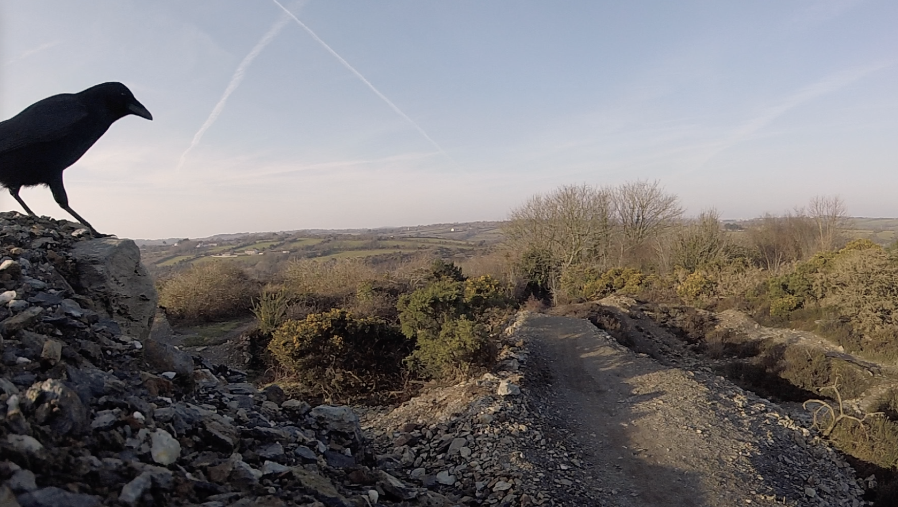
Mountain Biking @ Wheal Maid – Poldice

Slide 2
Mountain biking @ Poldice – a brief history
The Wheal Maid valley area near St Day area has become popular with mountain bike riders over the last 20+ years
The area has been ‘adopted’ by the MTB community as an overlooked waste ground which has certain physical attributes making it a fun place to ride
Over the last 2 decades skill levels have improved and natural features have been incrementally developed by hand with the creation of jumps and banked sections (berms)
Today a small portion of the valley has become established as the “trail head” with trails runs leading away from that point (see aerial map)
Multi use trails exist across the whole of the Wheal Maid valley and further afield towards Unity Woods, the Bissoe valley and beyond
Whilst there is a general sense of community between all riders there is no formal club or membership associated to the people who ride there

Slide 3
Background
We 1st met with Parish Council Spring 2017 and discussed:
Safety concerns
Risk of multiple user types in close proximity
Sustainable access approach supporting ongoing use of the site
Signage & zoning
Insurance
Possibility of developing a club or community to help with communications
Moto cross bike use of site and associated risks
Littering
Open mine shaft
Several emails were sent by myself and Mark Bugden & myself regarding signage options and offering to assist with wording etc. but no further action taken by Councillors at that time

Slide 4
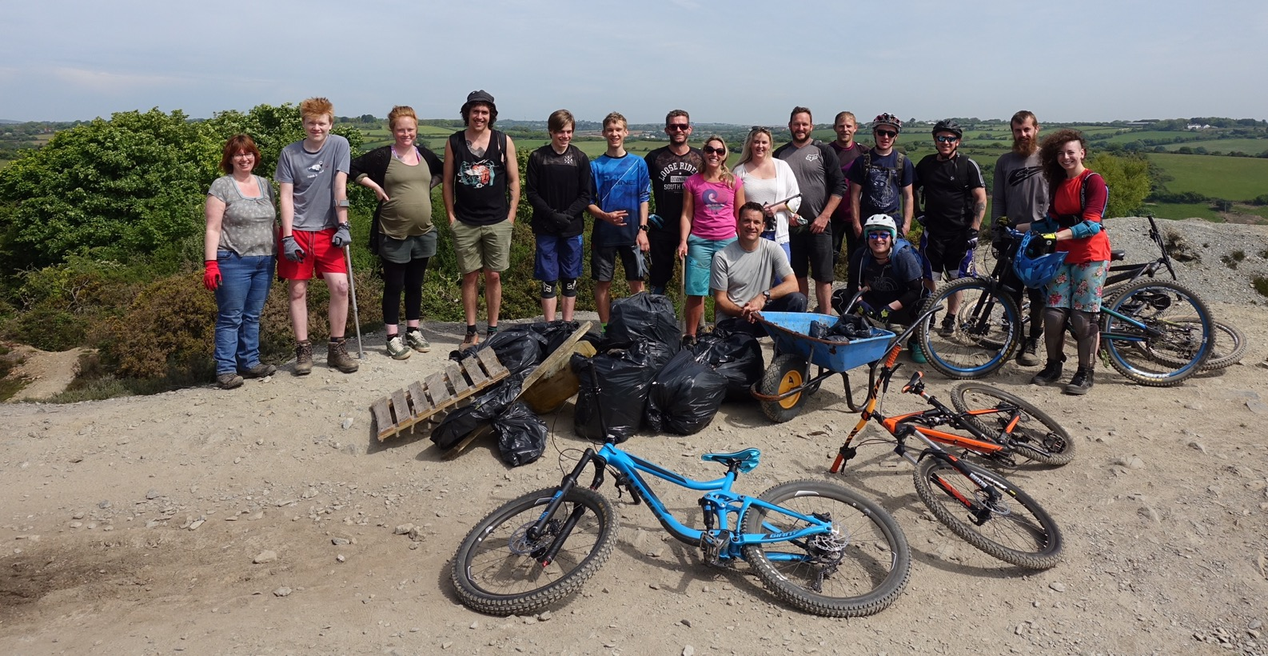
Background
Facebook group was established to help provide a focal point for community. The “Dice Rollers” group now 882 members
Litter pick organised Summer 2018 and ongoing voluntary activity to help keep the site tidy is now very good
An culture of respect and communal responsibility is developing well

Slide 5
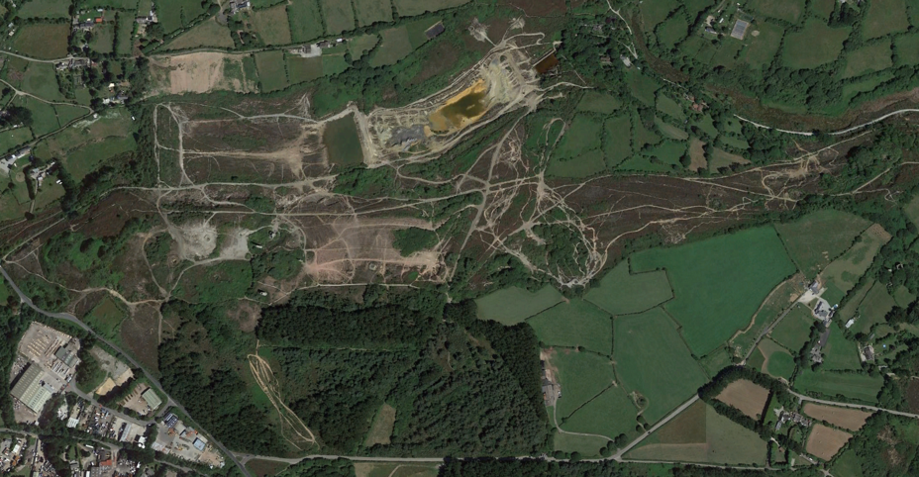
Aerial view showing high intensity usage zone – see shaded area
North

Slide 6
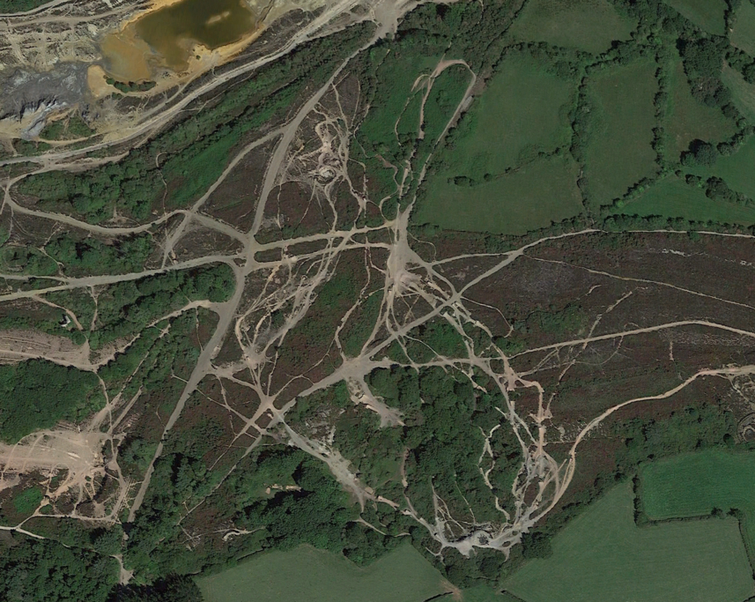
Aerial view showing principle crossing points and possible locations for signage and “caution zone” posts
Medium risk crossing zone
High risk crossing zone
Possible location for signage
Possible location for boundary posts
Principle trail head

Slide 7
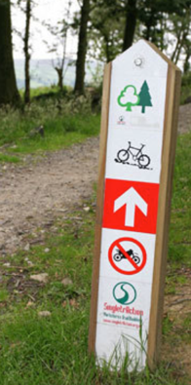
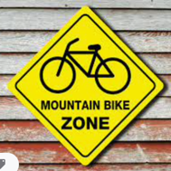
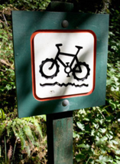
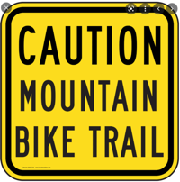
Safety
As seen with numerous Forestry Commission sites, multi use areas can be made to work safely.
A considered approach can:
Increase awareness amongst all users
Increase safety
Reduce the risk of collision and accident
Maintain overall access without the use of unpopular and difficult to impose bans and restrictions
Zoning – establishing and signing high intensity usage zones
Signage – Clear signage highlighting cross trail areas on perimeter of zone
“Please keep you dog on a lead – mountain bike trail crossing ahead”

Slide 8
Development and promotion of Poldice
and Bissoe valley area as an MTB destination?
Nothing beats the freedom of exploring new places by bike. Cycling gives people a close-up experience of the history, landscape and character of a place in a healthy and active way, while providing a boost to local businesses and avoiding additional traffic congestion.
Cycle tourism makes a significant contribution to the UK economy, with particular benefits for small businesses in rural areas. Places that have taken steps to attract cyclists by developing great routes and facilities have seen the benefits first-hand.

Slide 9
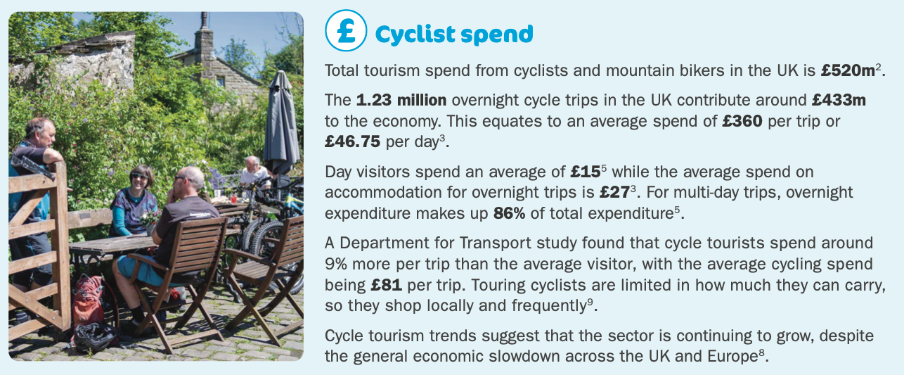
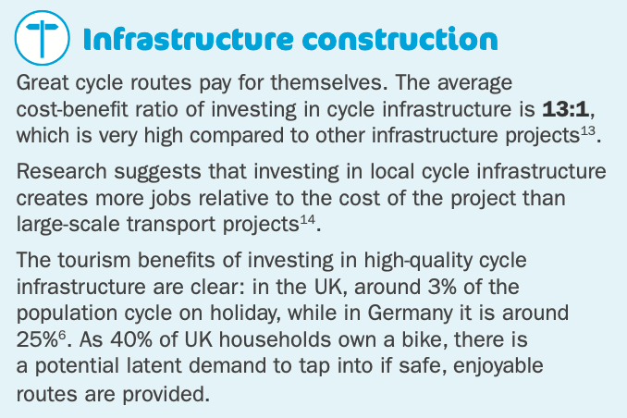
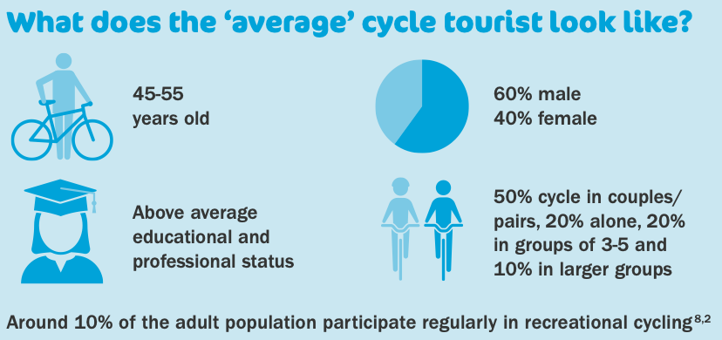
July 2020 Cycling UK Report

Slide 10
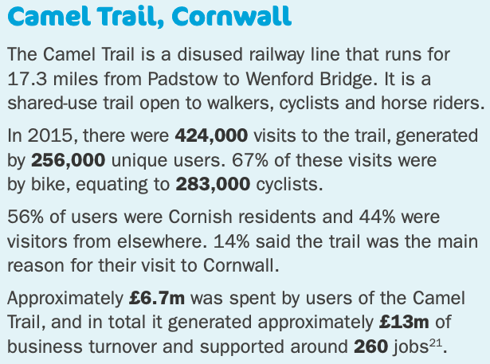
Camel Valley Case Study
https://www.cyclinguk.org/sites/default/files/document/2020/07/benefits_of_cycle_tourism_factsheet_final10738.pdf

Slide 11
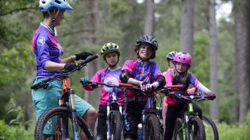
Bikepark Wales Case Study
https://www.telegraph.co.uk/business/success-in-wales/investing-in-sport/

