Slide 1
Cornish Metals’ Diamond Drilling Update
Gwennap Parish Council Meeting
12 October 2021

Slide 2
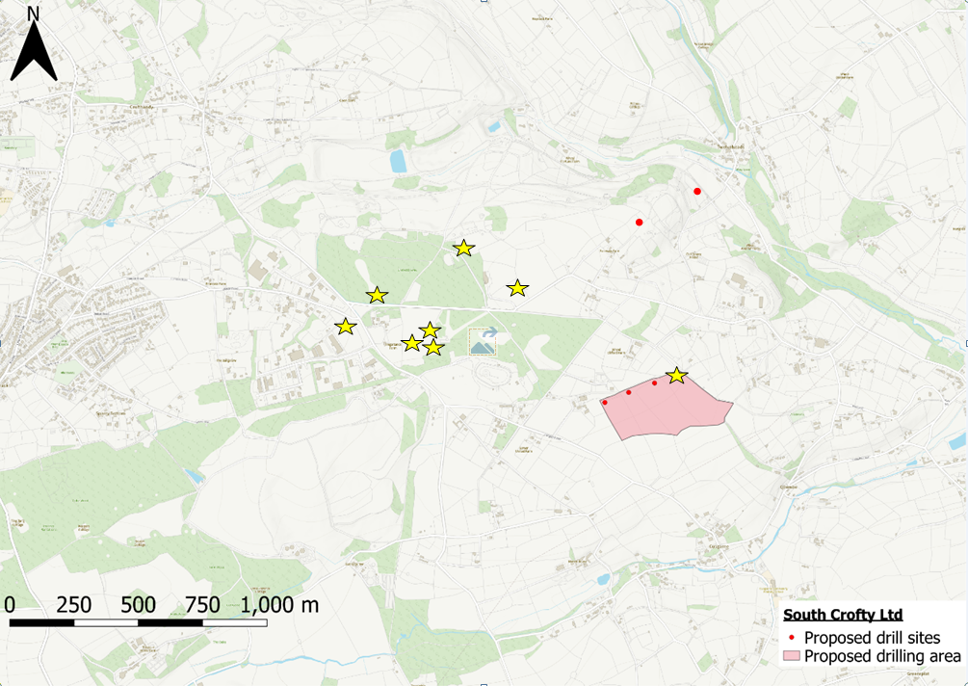
United Downs Drilling 2021
We have been drilling in the United Downs area since April 2021.
Our initial program, targeting the newly identified ‘UD21 Lode’ focused on four drilling locations between the old Consolidated and United Mines. Drilling is concluding on this program in late October.
In addition, we have been conducting desktop studies to identify and investigate other prospective mineralised areas in the vicinity.
As such, we commenced diamond drilling on the ‘Trenares Lode’ program in September 2021. Drilling is expected to continue on this program until the New Year.
Our next proposed diamond drilling target is the downdip extension of the main lodes worked by Mount Wellington Mine.
Crofthandy
Twelveheads
Carharrack
Mt Wellington Mine
Cusgarne
Completed Drill Sites

Slide 3
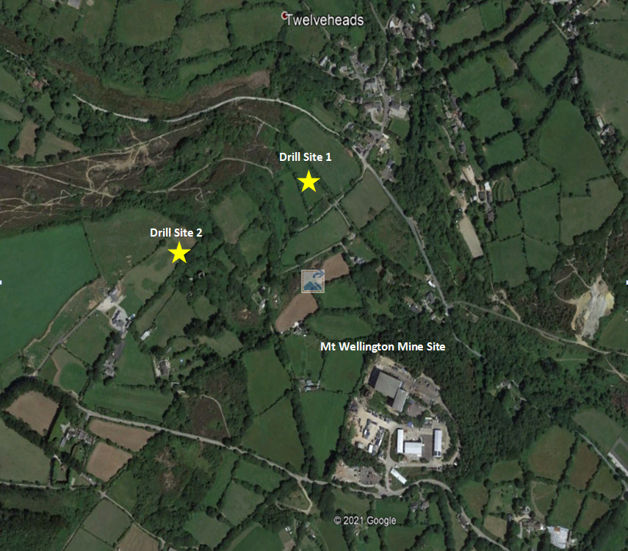
Proposed Drilling at Mount Wellington
Both Mount Wellington, and Wheal Jane to the east, worked the same lode structures, with the lodes at Wheal Jane being worked to depths of 500m from surface. However, the same structures at Mount Wellington were only worked to depths of around 200m from surface, with indications that they may continue at depths far below this.
We have identified two (2) potential drill sites to the north of Mount Wellington to drill approximately four (4) diamond drill holes to test the lodes at depths of around 400-500m from surface
We have been conducting household visits over the last month in the Twelveheads area ahead of submitting a GPDO to Cornwall Council for these drilling proposals.
Drilling is proposed to commence in early 2022 and continue for approximately 3 months.
Community Information Open Day events are planned for anybody who is interested, at Crofthandy Village Hall on 3rd November from 1130-1900 and at Twelveheads Sunday School Rooms on 2nd November from 1130-1900hrs.

Slide 4
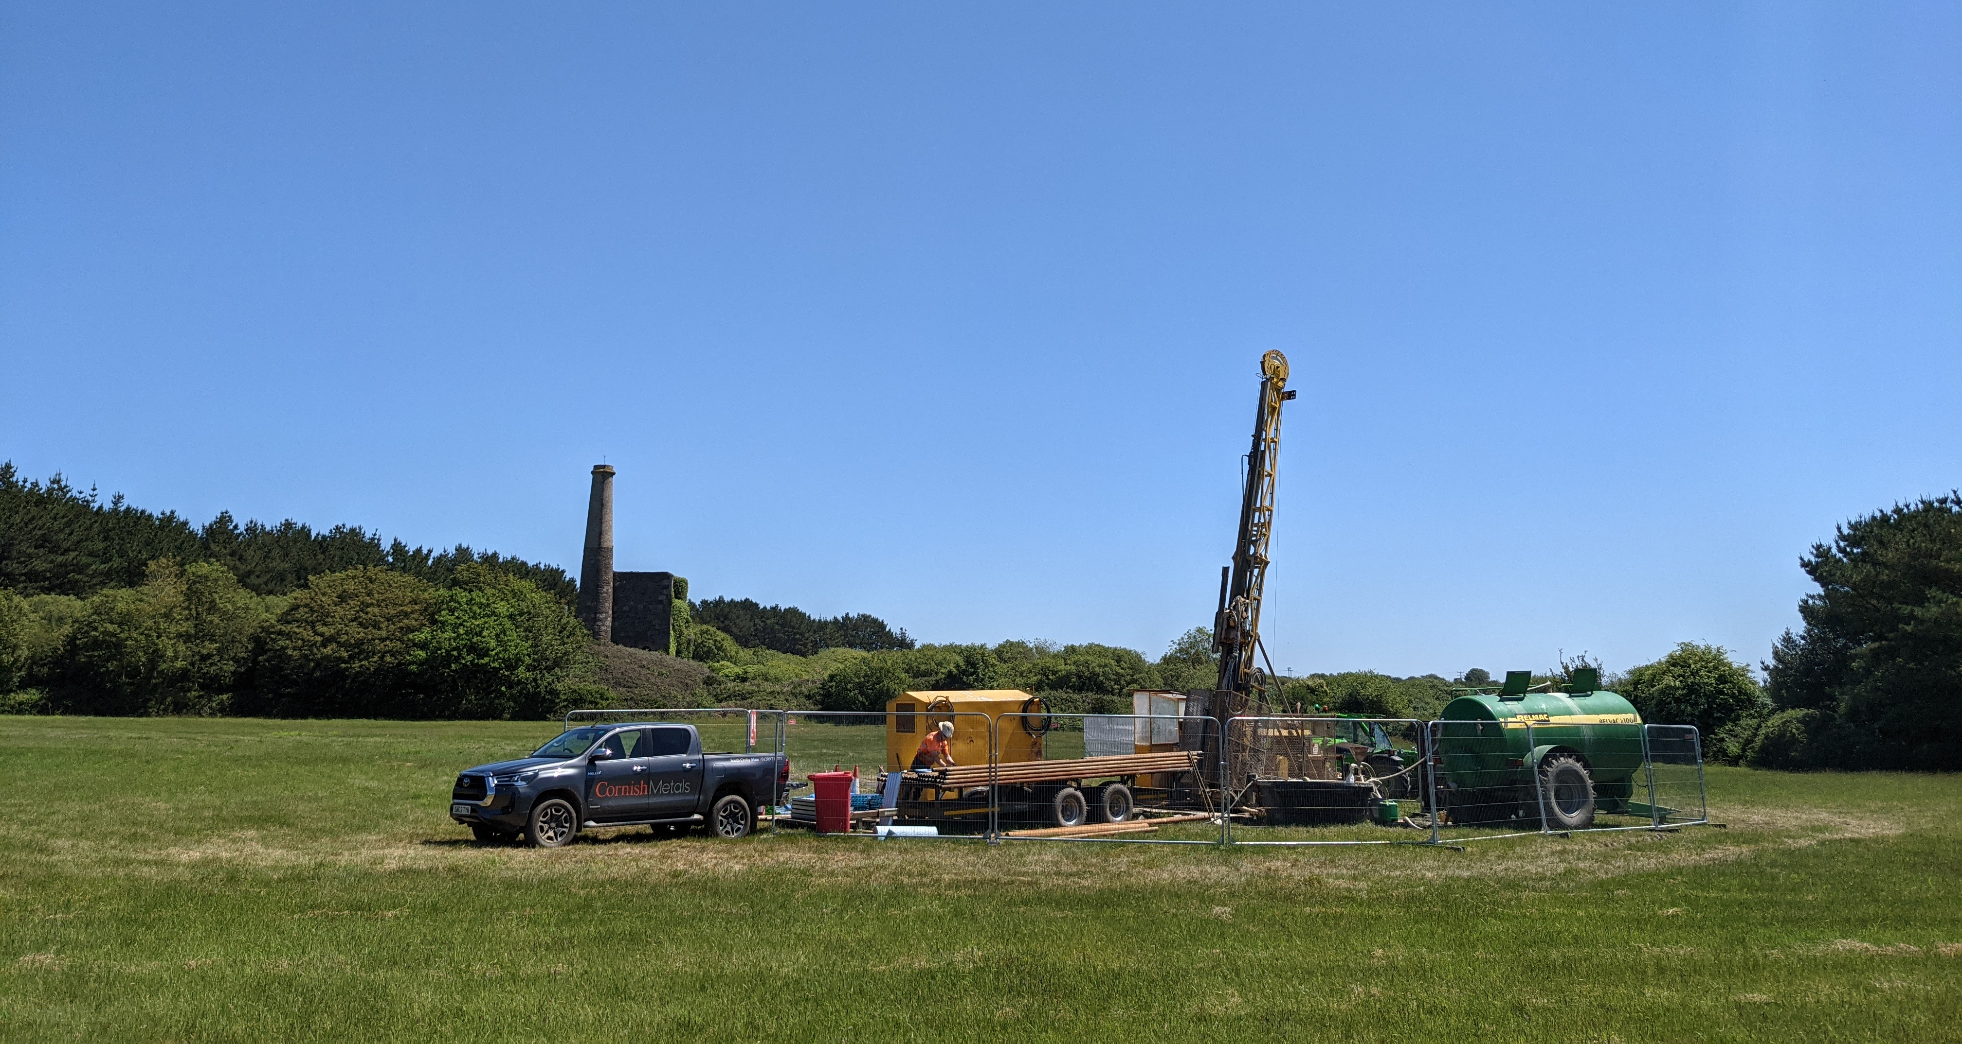
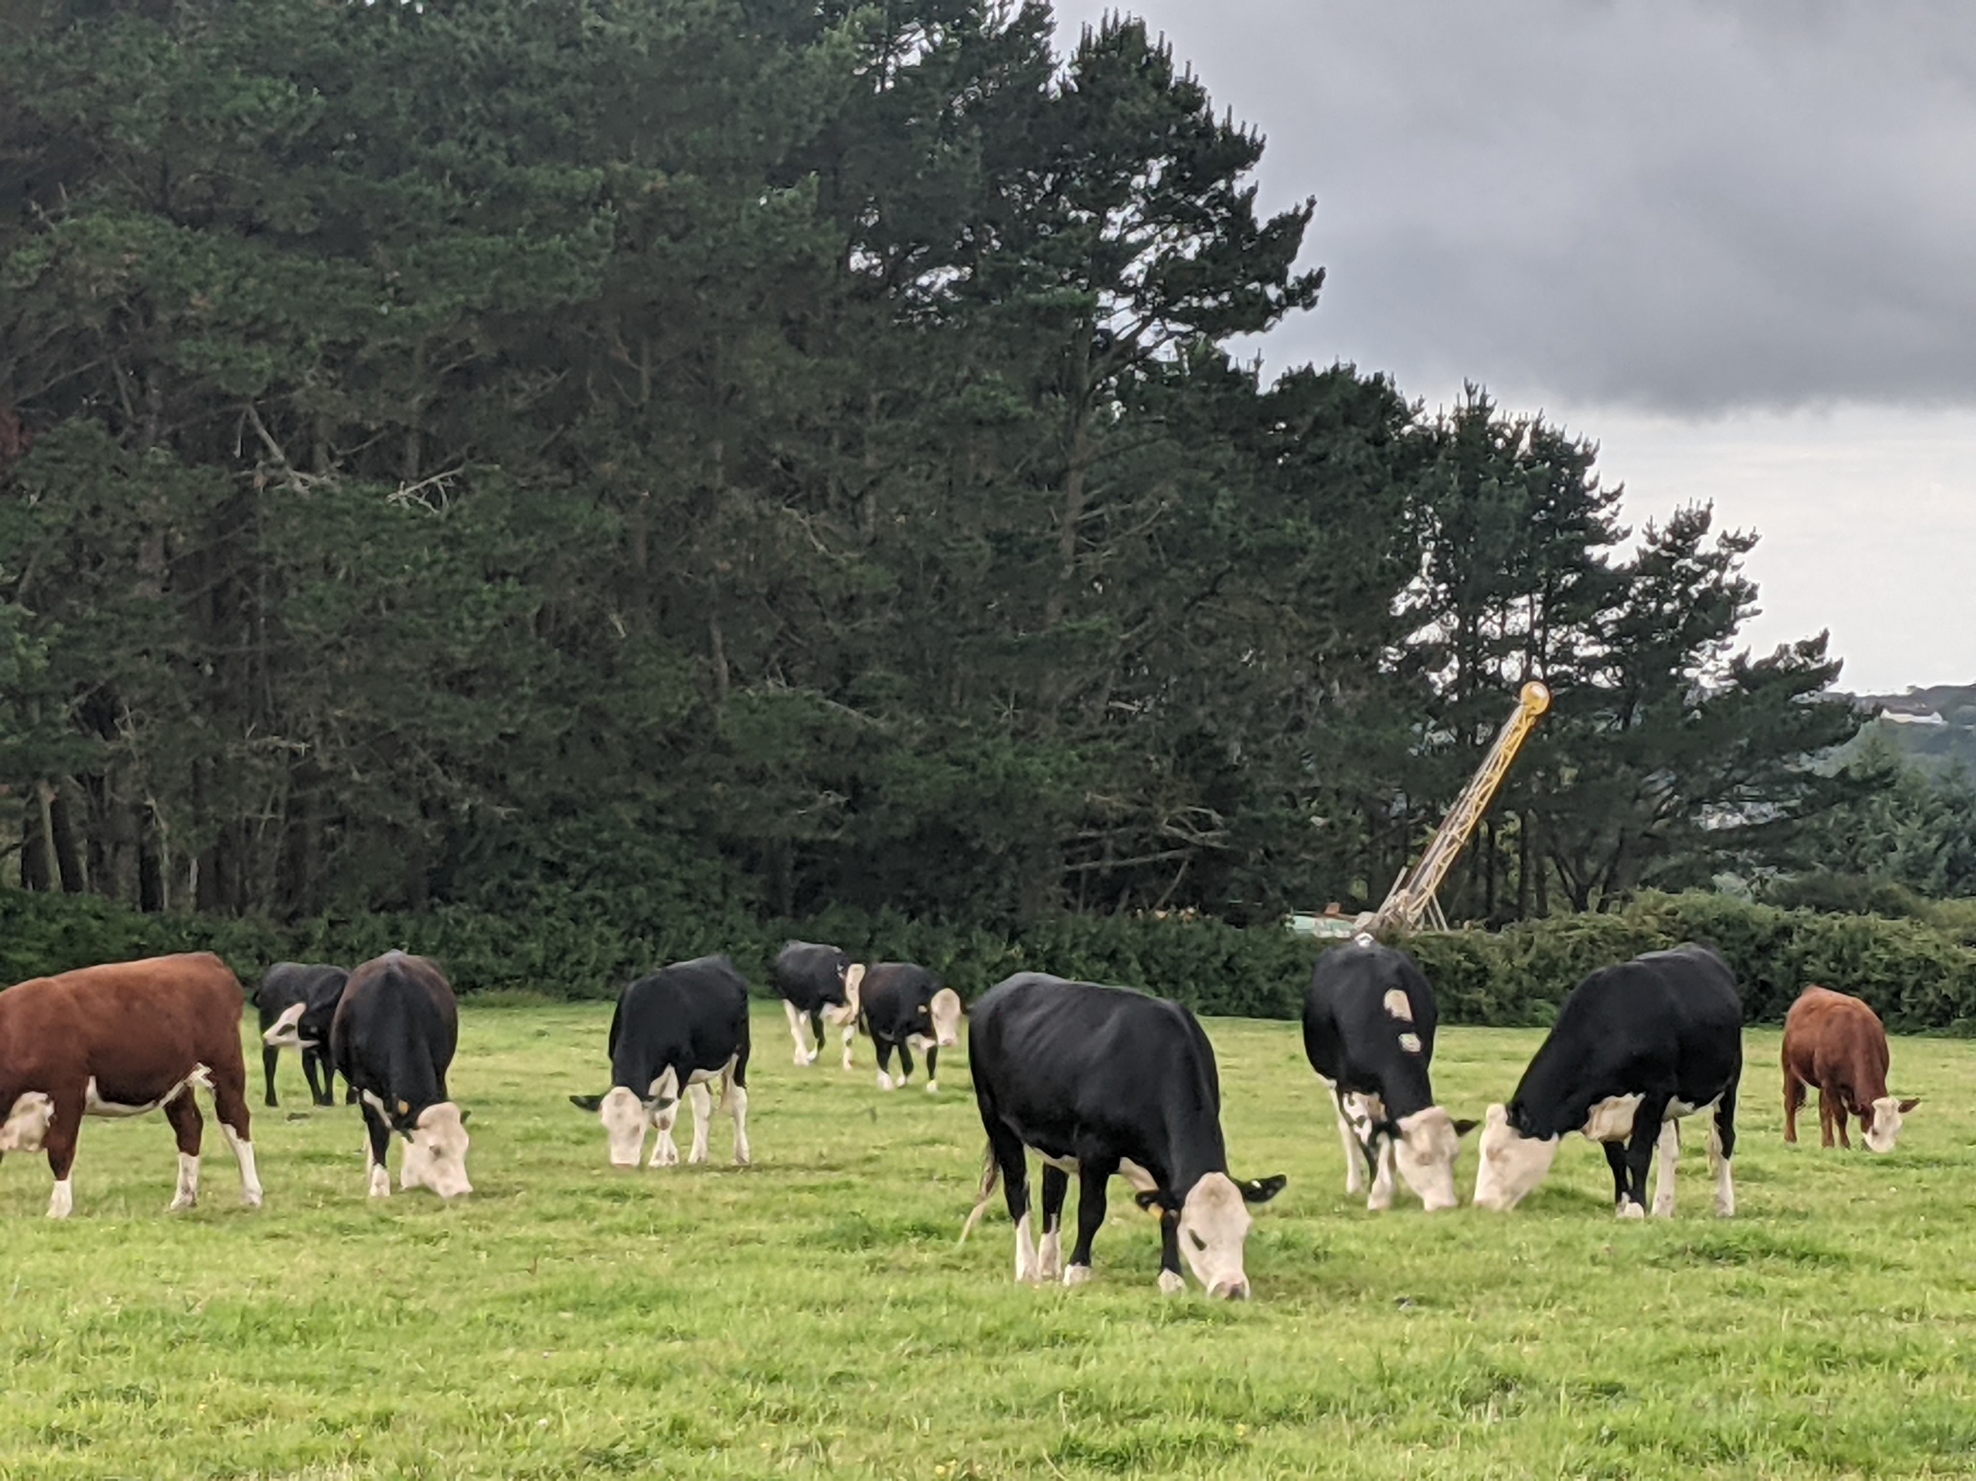
Our Diamond Drill Sites
Drilling at Site 4, United Downs, August 2021
Diamond drilling uses non-percussive, rotational core drilling to essentially act like an ‘apple-corer’ and extract intact rock samples from the ground to enable our team of geologists to build up a 3D picture of the mineral potential beneath the surface.
Drilling operations are between 7am and 7pm daily, with straw bales located around each site to attenuate noise levels.
As drilling is non-percussive, there is limited noise and no vibrations associated with the drilling itself. The predominant noise on-site is created by the diesel generator that powers the rig.
All drill sites are subject to following mitigation measures recommended in ecological and noise surveys conducted specifically for each drill site.
Drilling at Site 5, United Downs, September 2021
We will be submitting notification to the Mineral Planning Authority under a General Permitted Development Order (GPDO) to cover the proposed drilling program for Mount Wellington Deeps later in October 2021.
South Crofty Ltd agrees access arrangements with the relevant Landowners prior to submitting notification to Cornwall Council to conduct the diamond drilling under Permitted Development.
We also conduct community outreach activities in order to discuss our plans with local residents and provide an ‘open-door’ policy for questions and queries at all stages.
All drill sites are fully remediated following the completion of drilling activities.

Slide 5
Thank you
Any Questions?
For further information contact:
Tel: 01209 715777
Email: enquiries@wum.uk.com

